Slide 1
Convolutional Neural Networks CNN
Day 3
Ali Ramadan
NLP Team Leader, RDI

Slide 2
Content
Why CNN?
Convolution Operation
CNN Tricks
Computer Vision Examples

Slide 3
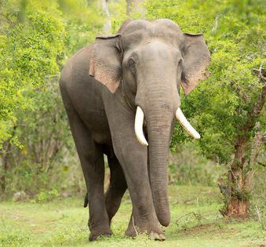
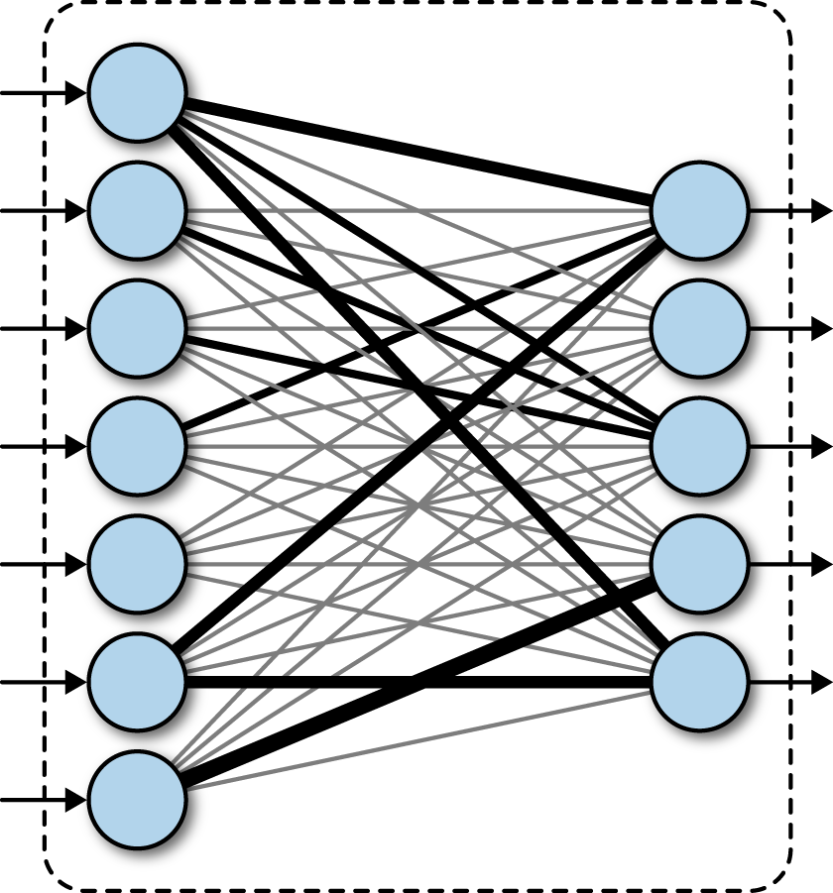
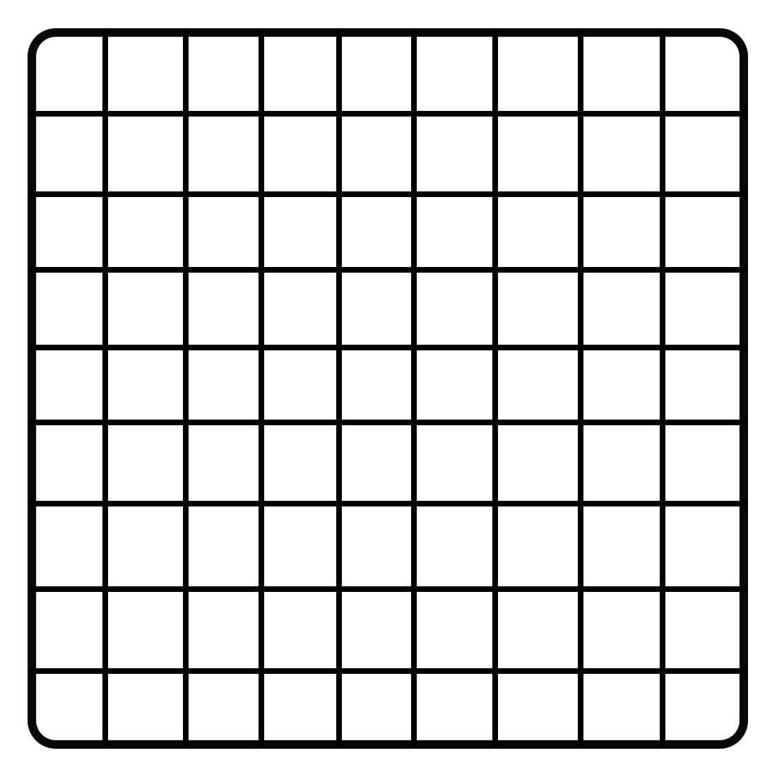
Why CNN?
Model
Elephant
Elephant
500X 500 X 3
750000
1000
750M

Slide 4
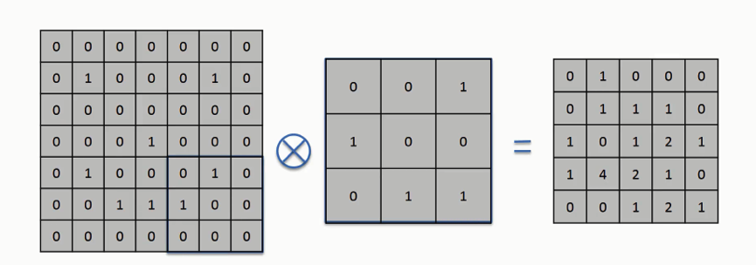
Convolution Operation
F X F
3 X 3
M X M
5 X 5
N X N
7 X 7
(N-F+1) X (N-F+1)

Slide 5
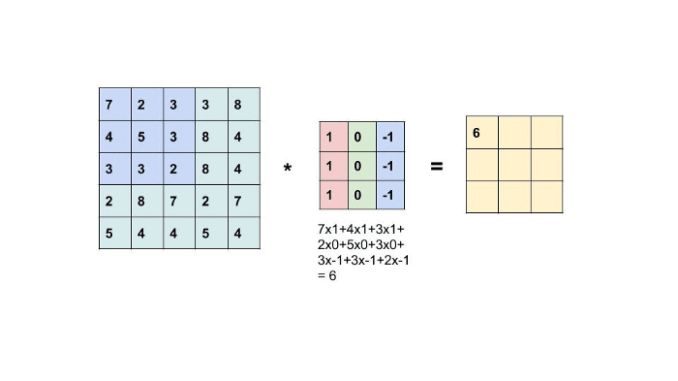
Convolution Operation

Slide 6
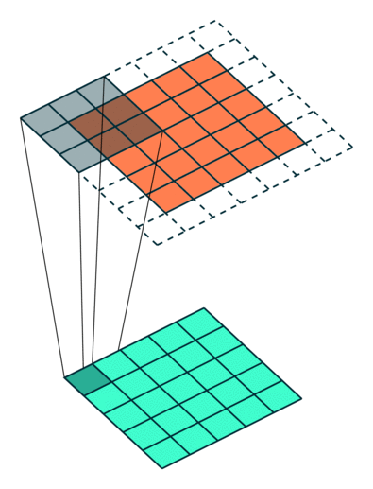

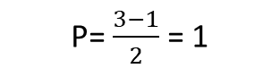
Convolution Operation Padding
Same output size as input
(N-F+1) X (N-F+1)
More accurate feature representation
(N+2P-F+1) X (N+2P-F+1)
P = $\frac{F−1}{2}$
N = 7 F = 3 M = 5
P= $\frac{3−1}{2}$ = 1

Slide 7

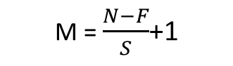
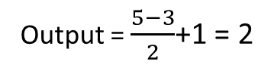
Convolution Operation Stride
2 X 2
M = $\frac{N−F}{S}$+1
N = 5 F = 3 S = 2
Output = $\frac{5−3}{2}$+1 = 2
5 X 5

Slide 8

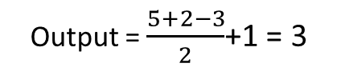
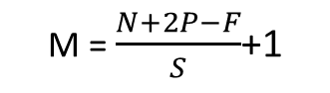
Convolution Operation Stride With Padding
3 X 3
M = $\frac{N+2P−F}{S}$+1
N = 5 F = 3 S = 2 P = 1
Output = $\frac{5+2−3}{2}$+1 = 3
5 X 5

Slide 9
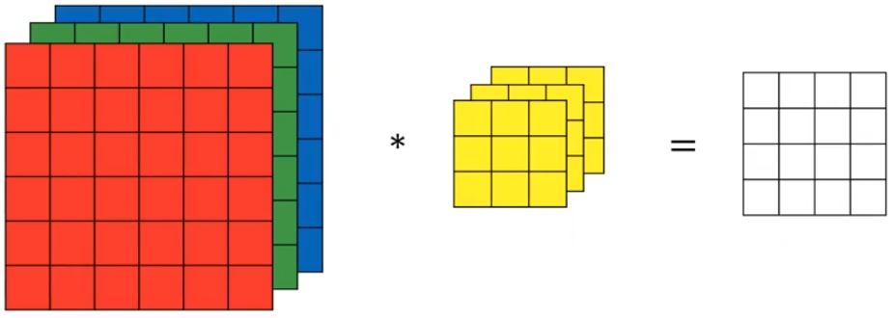
Convolution Operation 3D
3 X 3 X 3
4 X 4
6 X 6 X 3

Slide 10
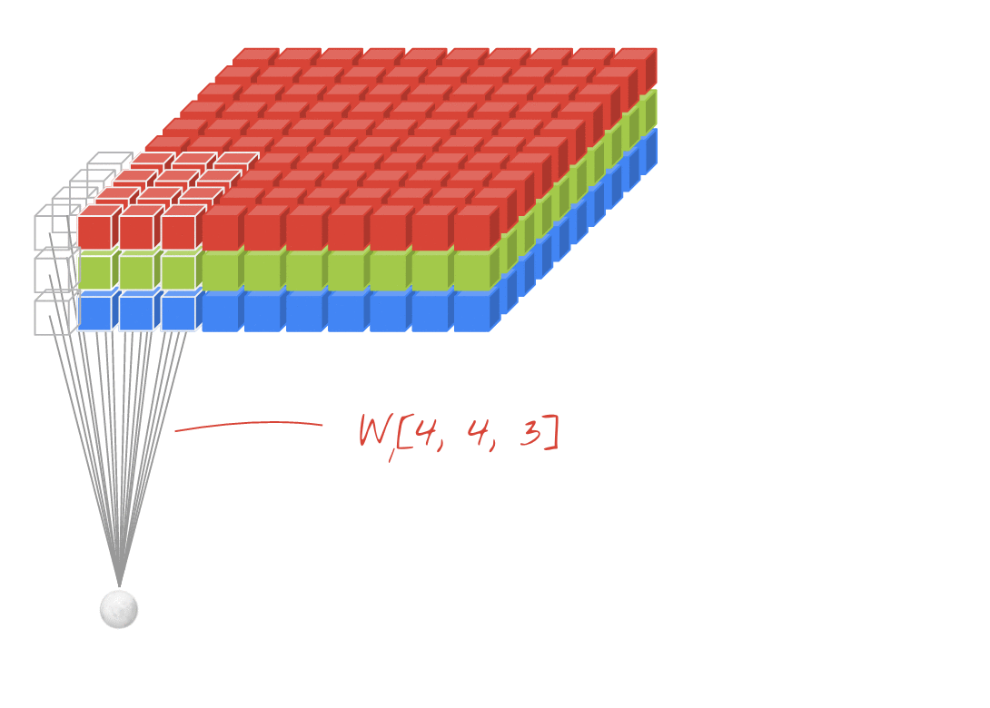
Convolution Operation 3D

Slide 11
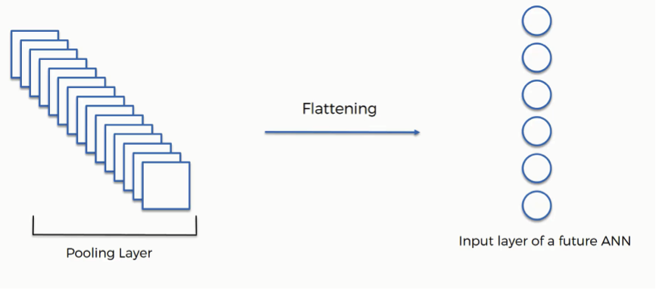
Convolution Operation Number of Parameters
500X 500 X 3
10 Filter Types
Elephant
498 X 498 X 10
3X3X3
W=3X3X3X10=270
Flatten 2.5M

Slide 12
Convolution Operation Number of Parameters
500X 500 X 3
10 Filter Types
Elephant
250 X 250 X 10
3X3X3
Stride = 2
Flatten 625K
W=3X3X3X10=270

Slide 13
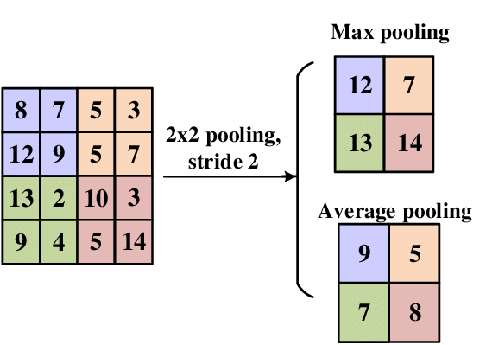
Convolution Operation Pooling

Slide 14
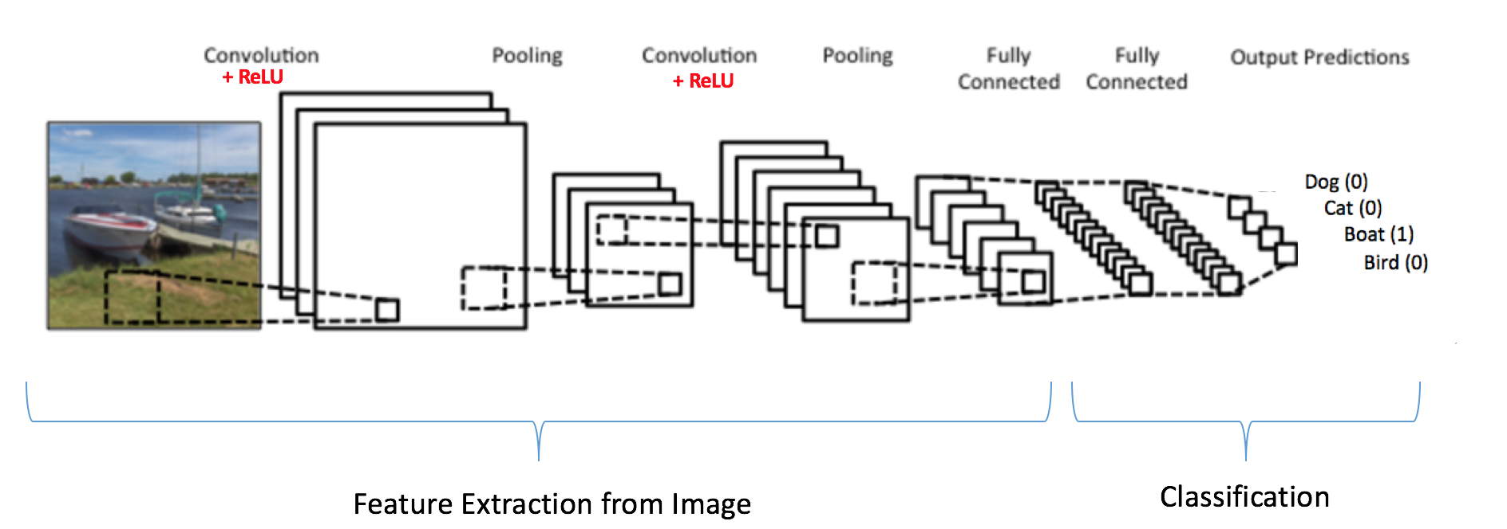
Convolution Operation Full Model

Slide 15

CNN Tricks Global Pooling
Training
Test
500X 500 X 3
10 Filter Types
1000 X 1000 X 3
Elephant
498 X 498 X 10
3X3X3
998 X 998 X 10
W=3X3X3X10=270
Flatten 2.5M
Flatten 10M

Slide 16
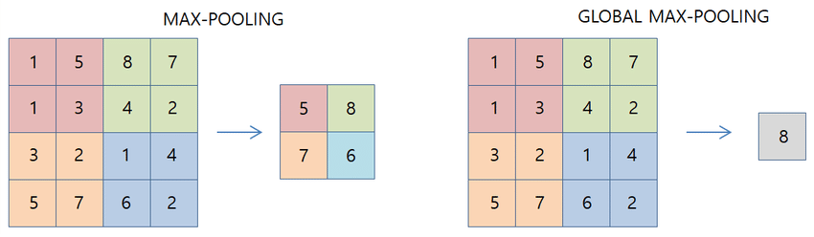
CNN Tricks Global Pooling

Slide 17

CNN Tricks Global Pooling
Training
Test
500X 500 X 3
10 Filter Types
1000 X 1000 X 3
Global Pooling
Elephant
498 X 498 X 10
3X3X3
998 X 998 X 10
W=3X3X3X10=270
Flatten 10
Flatten 10

Slide 18
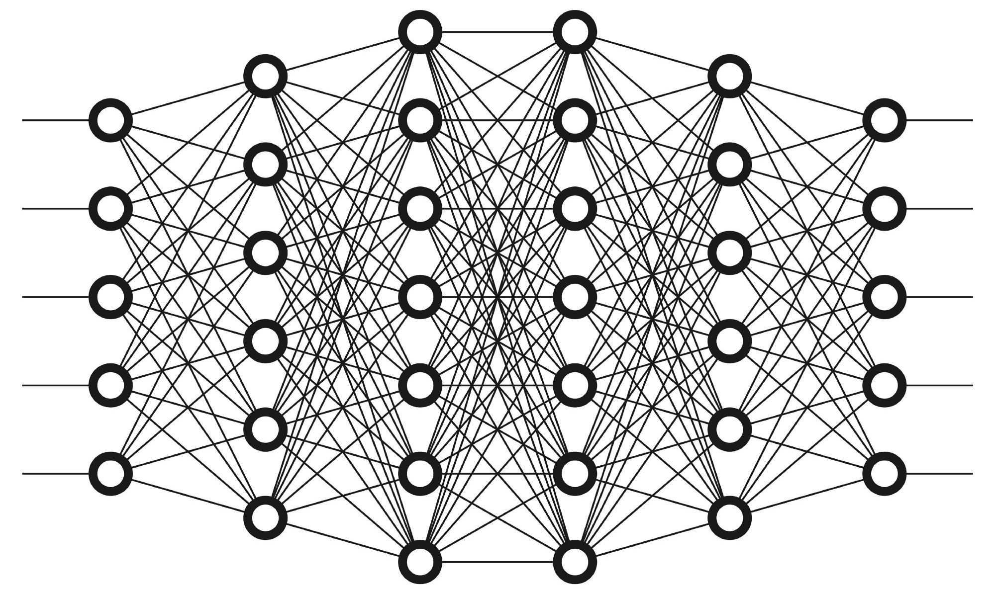
CNN Tricks Residual Blocks
More Data + Complex Tasks = Deeper Model
Huge Number Of Parameters
Forgetting Input

Slide 19
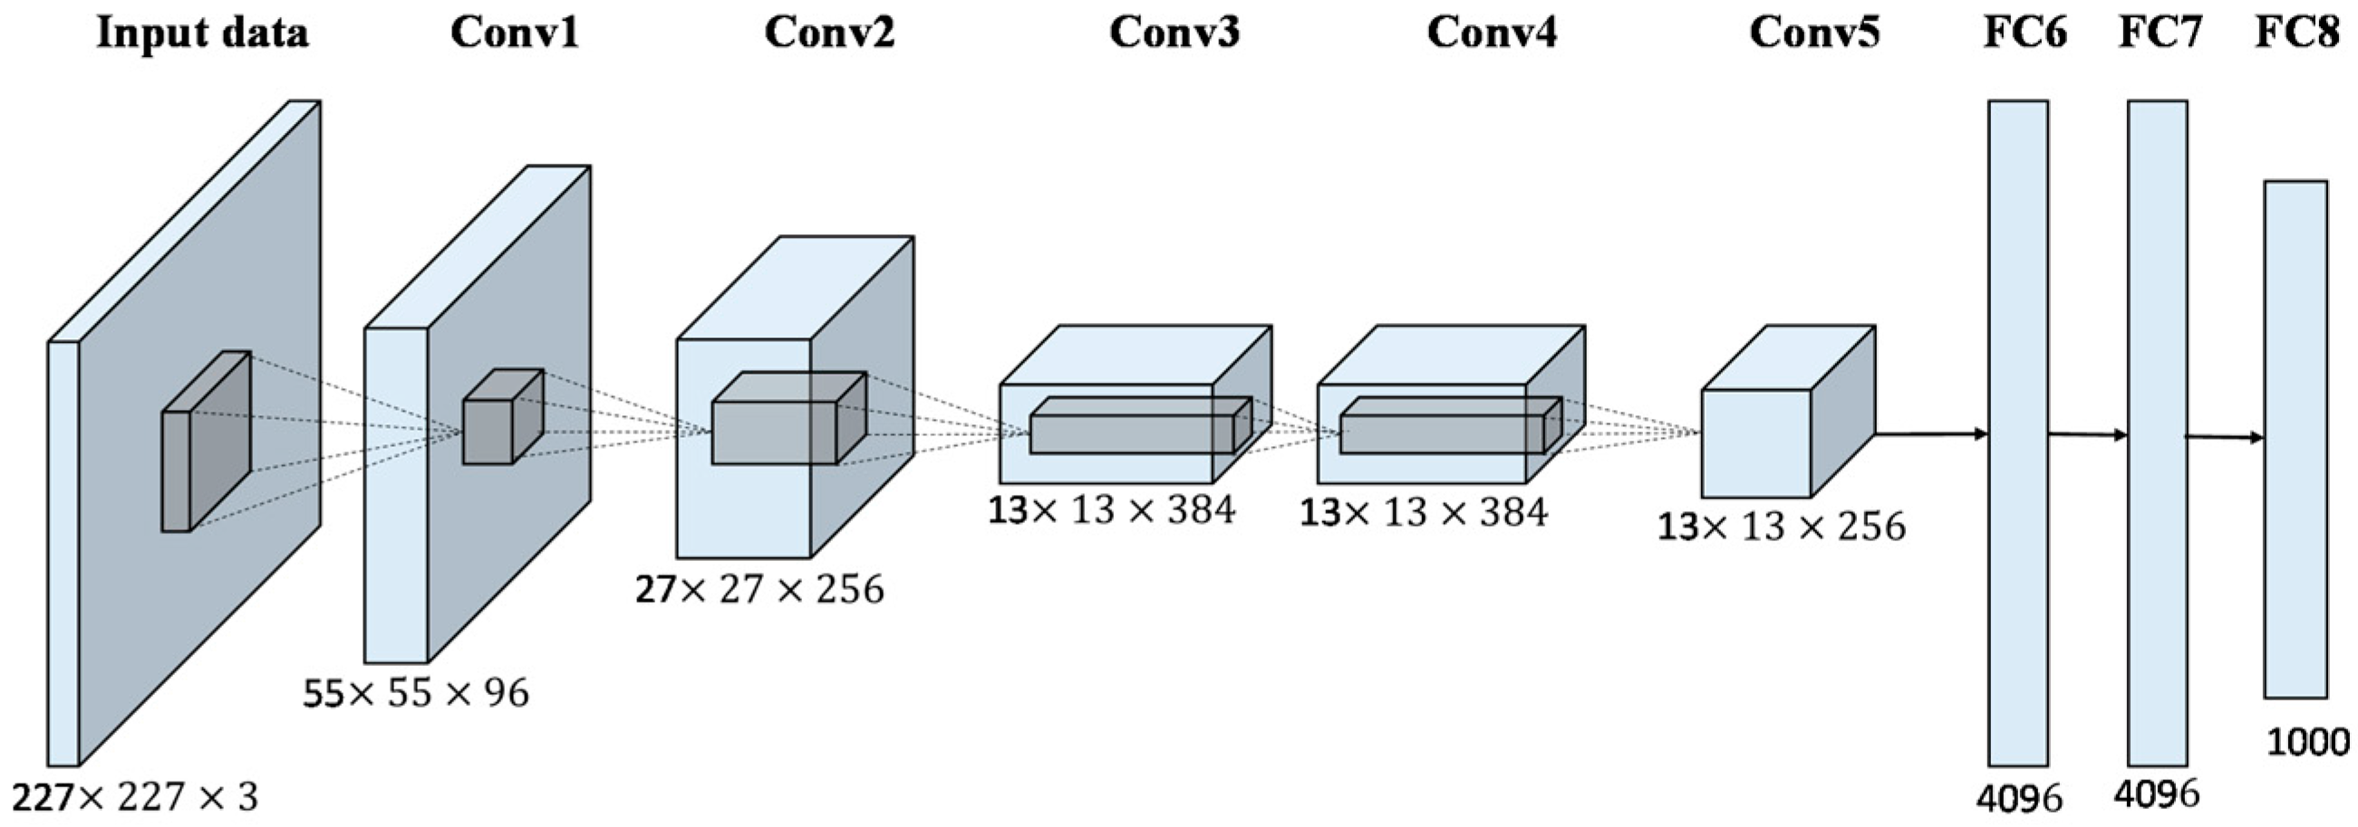

CNN Tricks Residual Blocks
More Data + Complex Tasks = Deeper Model
Huge Number Of Parameters
Forgetting Input

Slide 20
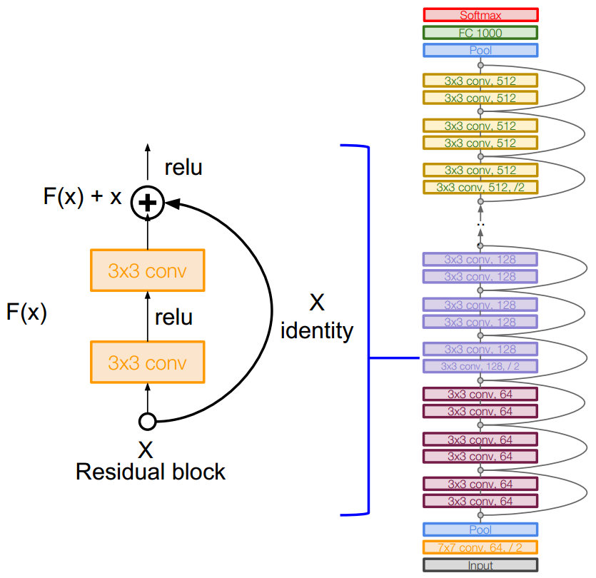
CNN Tricks Residual Blocks
More Data + Complex Tasks = Deeper Model
Huge Number Of Parameters
Forgetting Input

Slide 21
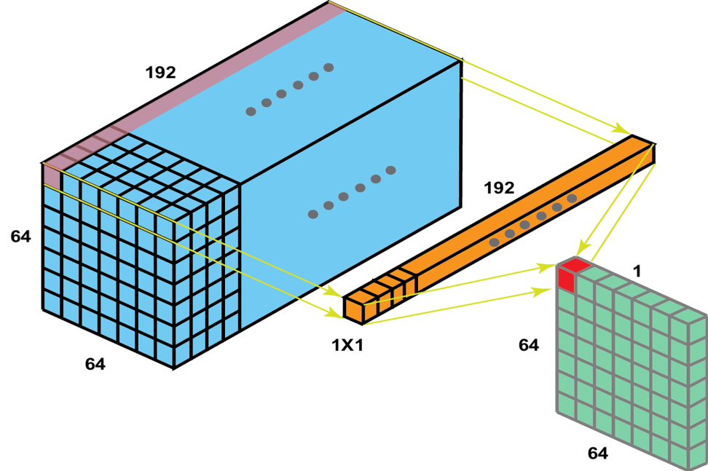
CNN Tricks One By One Conv
Act like a fully connected layer

Slide 22
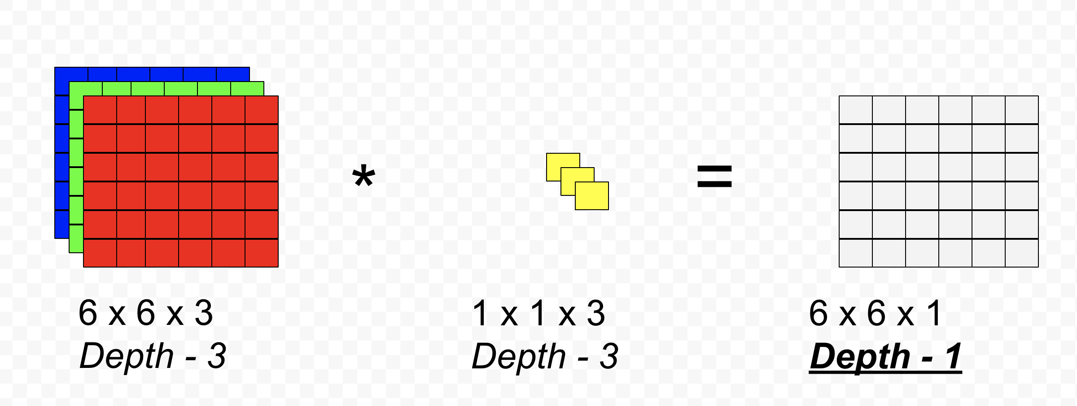
CNN Tricks One By One Conv
Constructing Images
Pixel Level Predictions
Multi-Targets Model
3 Filters
6 X 6 X 3
6 X 6 X 3
1X1X3

Slide 23

CNN Tricks One By One Conv
Controlling the number of channels
5 Filters
6 X 6 X 3
6 X 6 X 5
1X1X3

Slide 24
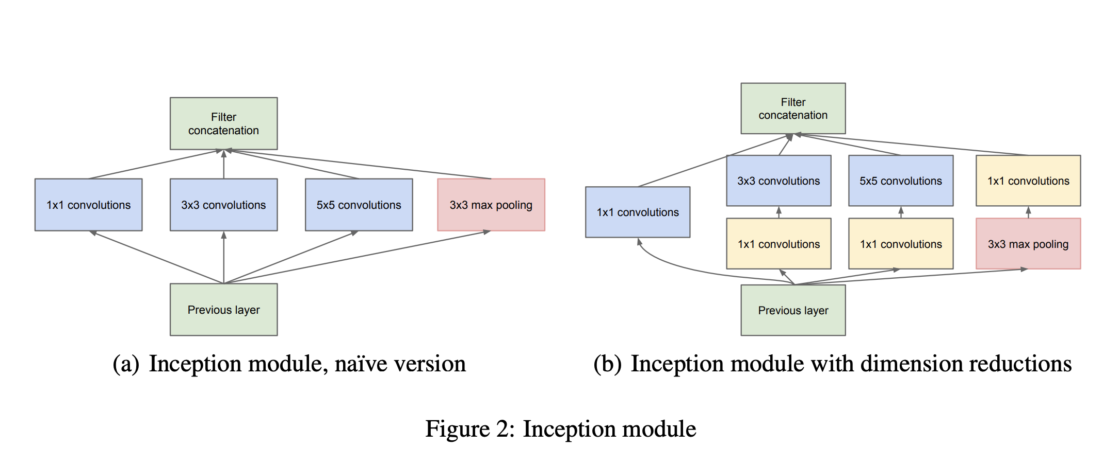
CNN Tricks Inception Network

Slide 25
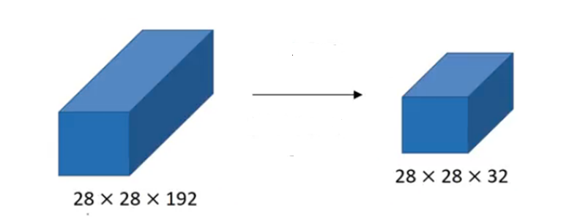
CNN Tricks Inception Network
Conv 5 X5 X192
32
Same
28 X 28 X 192 X 5 X 5 X 32 = 120M Operations

Slide 26
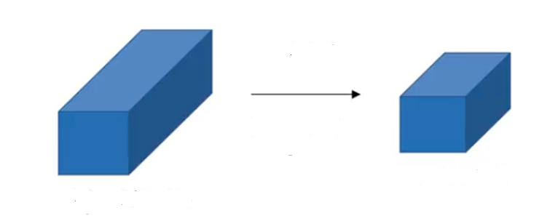
CNN Tricks Inception Network
1 X 1 X 192
5 X 5 X 16
16
Same
32
Same
28 X 28 X 16
28 X 28 X 32
28 X 28 X 192
28 X 28 X 192 X 1 X 1 X 16 = 2.4M Operations
28 X 28 X 16 X 5 X 5 X 32 = 10M Operations
12.4M <<< 120M

Slide 27
CNN Tricks Inception Network

Slide 28

CNN Tricks Dilated Conv

Slide 29
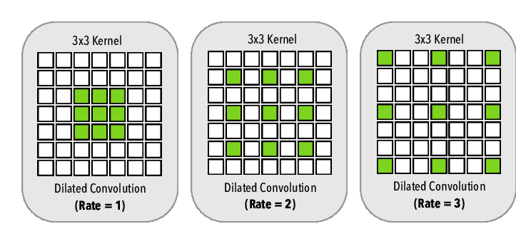
CNN Tricks Dilated Conv
Respective Field
The Receptive Field (RF) is defined as the size of the region in the input that produces the feature
RF = r X (F-1) + 1
RF = 1 X (3-1) + 1 = 3
RF = 2 X (3-1) + 1 = 5
RF = 3 X (3-1) + 1 = 7

Slide 30
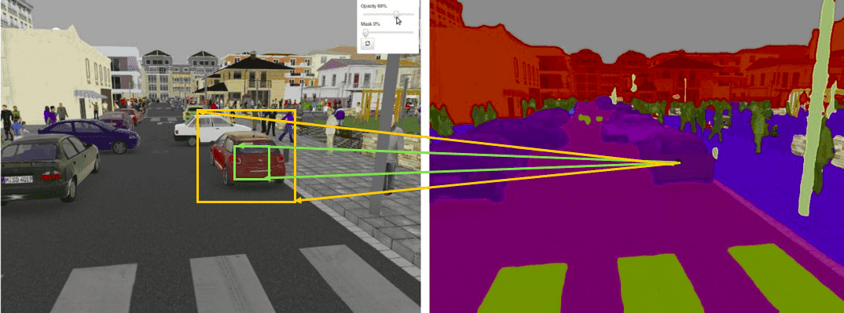
CNN Tricks Dilated Conv

Slide 31
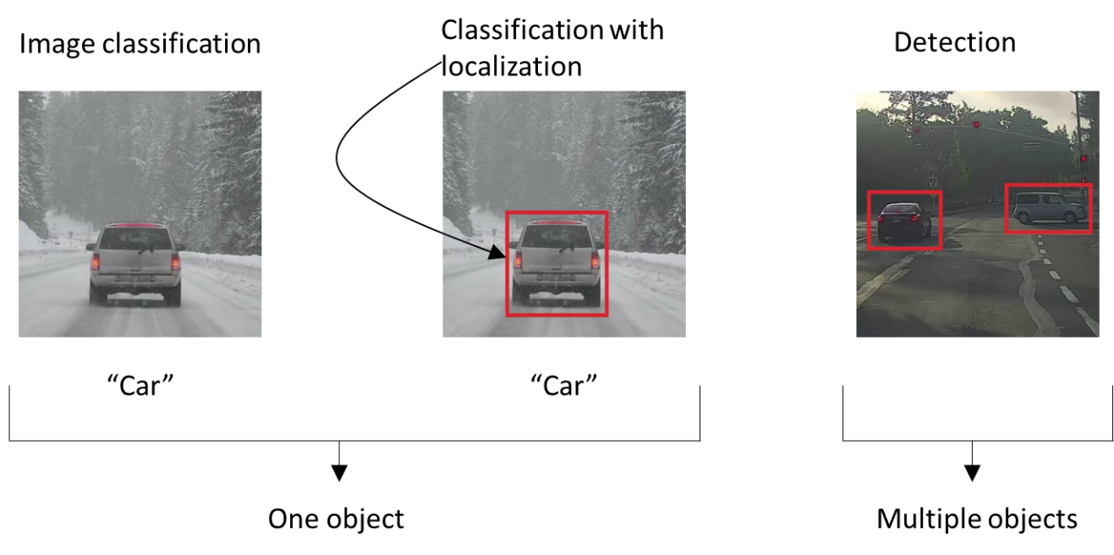
CNN Computer Vision Examples Localization VS Detection

Slide 32
CNN Computer Vision Examples Localization
SoftMax
Classification model
Car
CNN Layers
FC Layer
Output Layer
Input
Localization model
W
3 Classes + Background
(X,Y)
H
CNN Layers
FC Layer
X
Input
Y
W
H

Slide 33
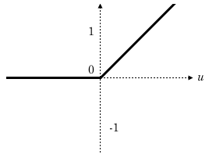

CNN Computer Vision Examples Localization
W
3 Classes + Background
(X,Y)
H
CNN Layers
FC Layer
X
250
Input
Y
600
512 X 512
W
200
H
700
ReLU

Slide 34
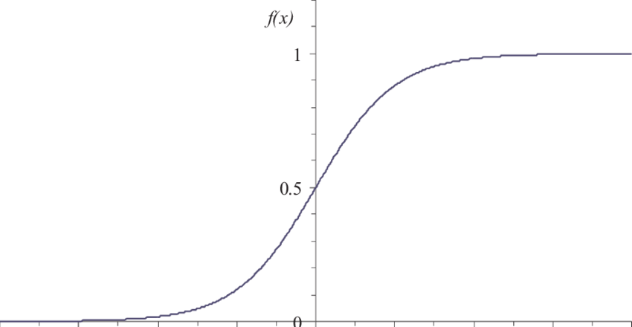
CNN Computer Vision Examples Localization
(0,0)
W
3 Classes + Background
(X,Y)
H
CNN Layers
FC Layer
X
0.5
Input
(1,1)
Y
0.8
512 X 512
W
0.5
H
0.5
Sigmoid

Slide 35
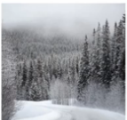
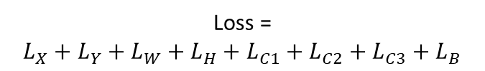
CNN Computer Vision Examples Localization
C1
Sigmoid OR SoftMax
C2
C3
3 Classes + Background
B
X
0.5
In this case we need to punish the model for all the output errors
In this case why we punished the model for all the localization errors
Y
0.8
W
0.5
H
0.5
Sigmoid
Loss =
$L_{X}+$ $L_{Y}+L_{W}+$ $L_{H}+$ $L_{C1}+L_{C2}+$ $L_{C3}+$ $L_{B}$

Slide 36
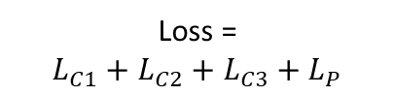
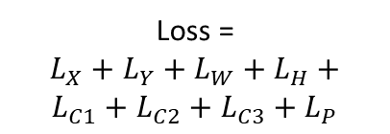
CNN Computer Vision Examples Localization
C1
SoftMax
C2
3 Classes
C3
Sigmoid
P
X
0.5
P = 1
P = 0
Y
0.8
W
0.5
Loss =
$L_{X}+$ $L_{Y}+L_{W}+$ $L_{H}+$ $L_{C1}+L_{C2}+$ $L_{C3}+$ $L_{P}$
Loss =
$L_{C1}+L_{C2}+$ $L_{C3}+$ $L_{P}$
H
0.5
Sigmoid
Loss =
$L_{X}+$ $L_{Y}+L_{W}+$ $L_{H}+$ $L_{C1}+L_{C2}+$ $L_{C3}+$ $L_{B}$
P = Probability of finding object

Slide 37
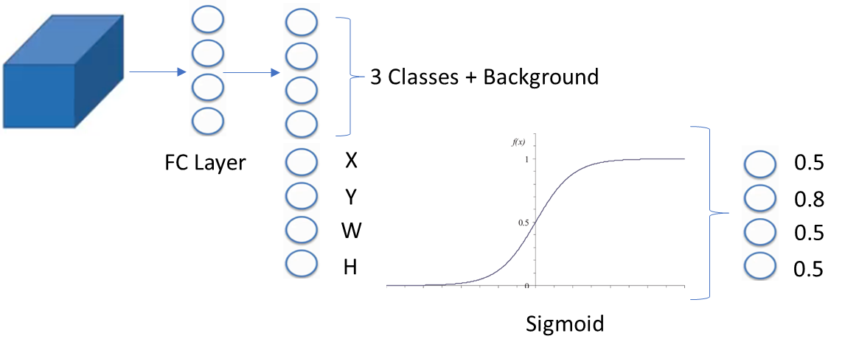
CNN Computer Vision Examples Detection
Multiple Objects
Single Object Model

Slide 38
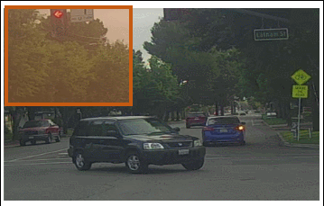
CNN Computer Vision Examples Detection
Sliding Window
Single Object Model

Slide 39

CNN Computer Vision Examples Detection
To many predictions
Sliding Window
Huge computational Cost

Slide 40
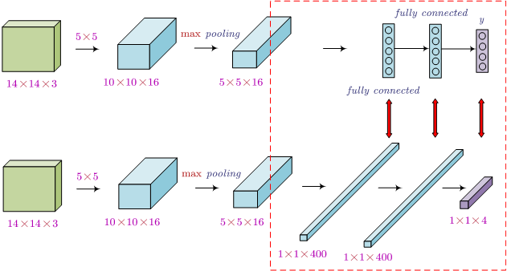
CNN Computer Vision Examples Detection
5 X 5 X3
16
C1
Convert FC to one-by-one conv
C2
C3
B
5 X 5 X 16

Slide 41
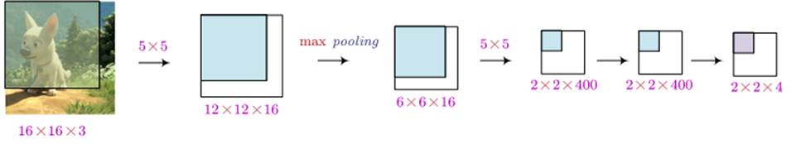
CNN Computer Vision Examples Detection
1 X 1
1 X 1
We can control the window size using pooling and Conv layers
We can control the number of targets using the number of filters at the last layer

Slide 42
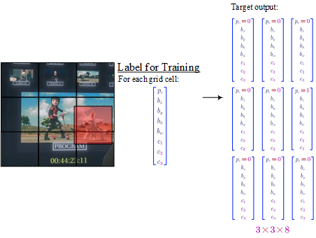
CNN Computer Vision Examples Detection
(0,0)
YOLO Algorithm
(X,Y)
(1,1)

Slide 43
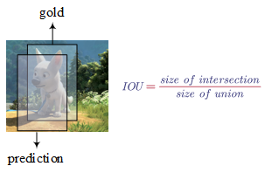
CNN Computer Vision Examples Detection
(0,0)
Evaluation
(X,Y)
Intersection Over Union
(1,1)
IOU can also be used to measure how similar two bounding boxes are similar to each other.

Slide 44
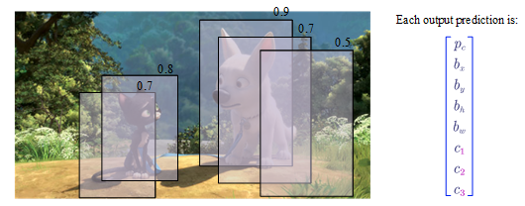
CNN Computer Vision Examples Detection
Non-max Suppression
(0,0)
Post-Processing
(X,Y)
(1,1)
We need to keep only one box per each group

Slide 45
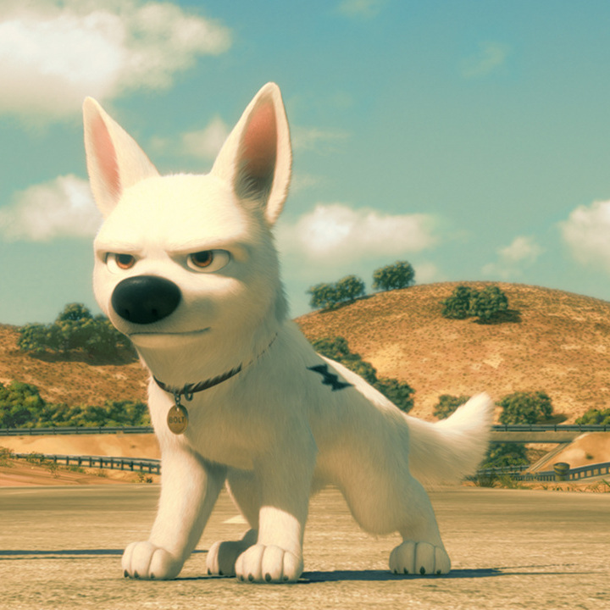
CNN Computer Vision Examples Detection
0.5
0.9
0.8
0.7
Non-max Suppression
Post-Processing
(1,1)

Slide 46
CNN Computer Vision Examples Detection
0.9
Non-max Suppression
Steps
0.8
0.7
Discard all boxes with
Pc ≤ 0.6
(1,1)

Slide 47
CNN Computer Vision Examples Detection
0.9
Non-max Suppression
Steps
0.8
0.7
Pick the box with the largest P as a prediction outputs
(1,1)

Slide 48
CNN Computer Vision Examples Detection
0.9
Non-max Suppression
Steps
Discard any remaining box with IOU ≥ 0.5 with the selected box in last step
(1,1)

Slide 49
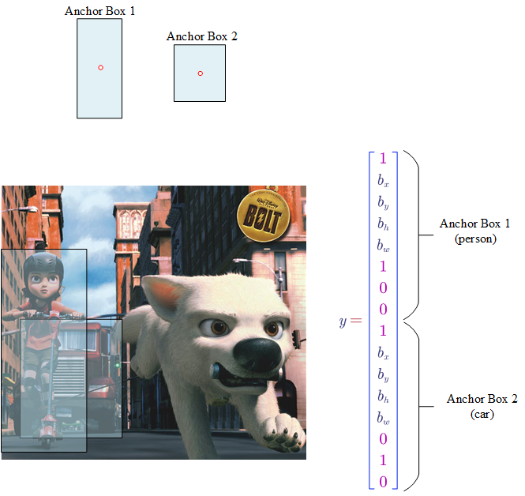
CNN Computer Vision Examples Detection
Multi Object Per Cell
Anchor Boxes
16
(1,1)

Slide 50
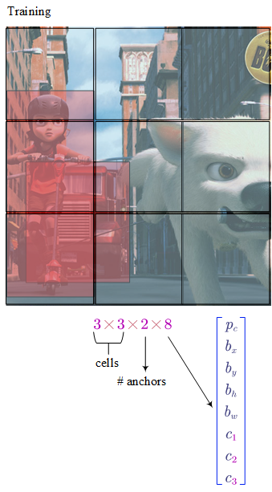
CNN Computer Vision Examples Detection
Anchor Boxes
Each object in a training image is assigned to:
A grid cell that contains the object’s mid point
An anchor box for the grid cell with highest IOU
(1,1)

Slide 51
CNN Computer Vision Examples Detection
Anchor Boxes
How many Anchors we need
(1,1)
Depending on your task

Slide 52
CNN Computer Vision Examples Detection
Anchor Boxes
How to select anchors boxes
Training Data
(1,1)
Clustering

Slide 53


